Slide 1
Network Devices, MAC & ARP
Presenter: Nguyen Manh Hung
Date: 06/11/2026
Embedded Trainees

Slide 2

OVERVIEW
1
2
3
Network devices
MAC Address
ARP Protocol
hub
bridge
switch
router
firewall
MAC Denifition, Purpose
MAC Types
MAC Address Table
ARP Definition
How ARP works
ARP Packet Structure
ARP Table
1/23

Slide 3

01
HARDWARE
Network devices
Physical infrastructure provides the foundation for all network traffic.
https://www.networkacademy.io/ccna/network-fundamentals/hubs-bridges-switches
2/23

Slide 4
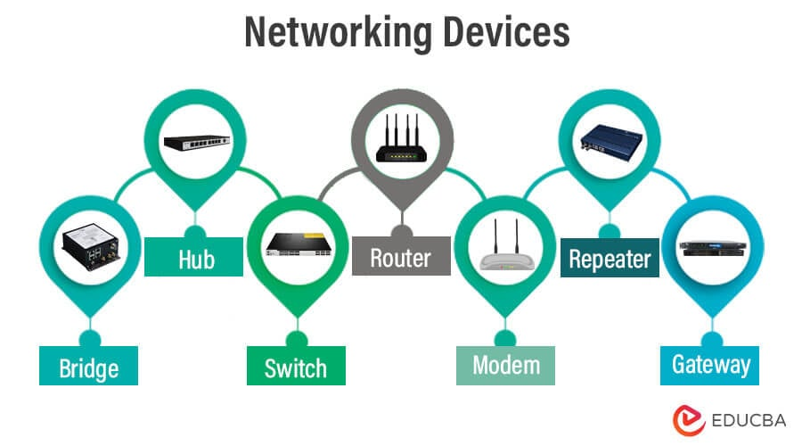
1. Network devices
3/23

Slide 5
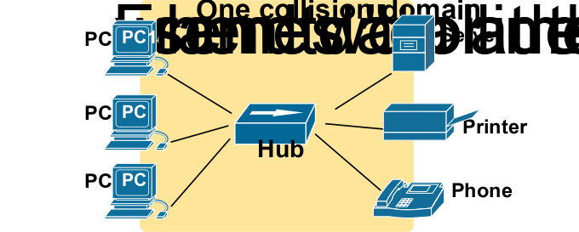
1. Network devices
Hub
Hub is a device that connects multiple devices and computers together. Hubs can also be called repeaters or concentrators because they act as the center of a local area network (LAN).
Layer 1
It takes an incoming signal on one port and broadcasts it to all other ports without knowing the recipient.
High network traffic collisions and security risks (everyone sees everyone's data).
It is a obsolete device, replaced by Switches.
4/23

Slide 6
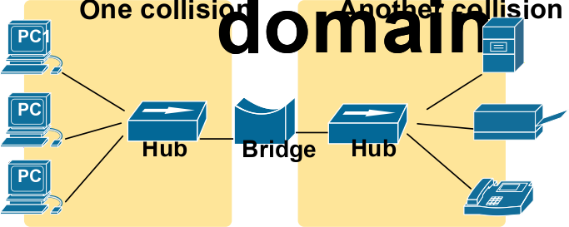
1. Network devices
Bridge
A bridge is a networking device that connects two or more Local Area Network (LAN) segments and enables communication between them.
5/23

Slide 7
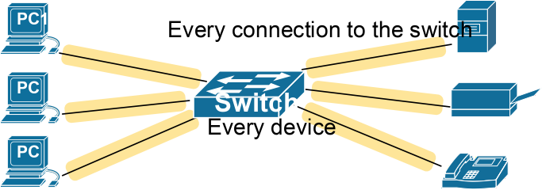
1. Network devices
Switch
A Network Switch is an intelligent networking device that main function is to connect multiple devices (such as computers, printers, servers, PLCs) within the same LAN.
Layer 2
Unlike hub, switch learns the MAC address of every connected device.
It sends data only to the specific port where the destination device is connected.
Reduces collisions and improves security and speed.
6/23

Slide 8
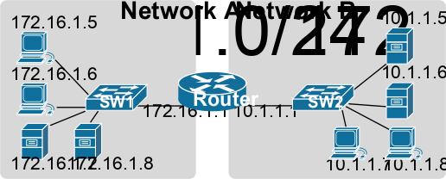
1. Network devices
Router
A router is a networking device that forwards data packets between different computer networks. It allows multiple devices to share an Internet connection efficiently.
7/23

Slide 9
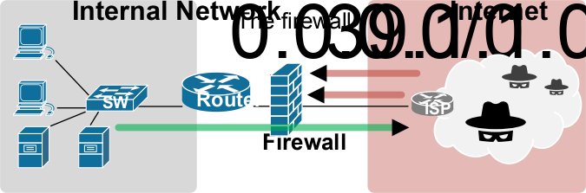
1. Network devices
Firewall
It is a network security system, comprising hardware, software, or both that monitors and controls incoming and outgoing network traffic based on predetermined security rules.
8/23

Slide 10
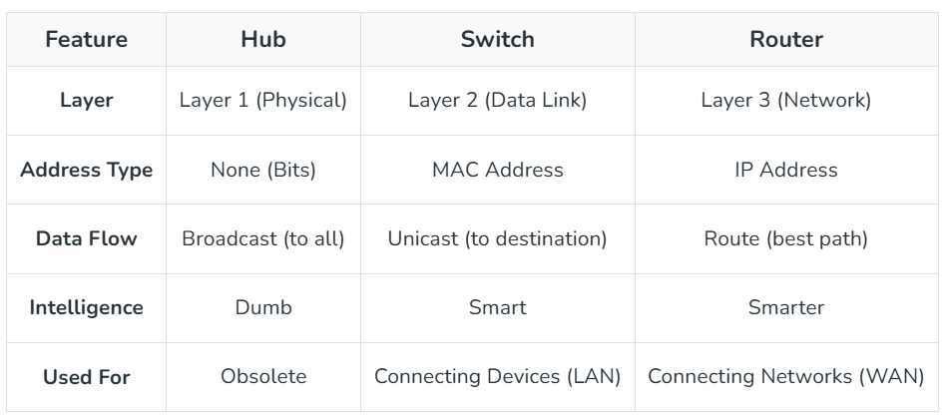
1. Network devices
Compare Hub, Switch and Router
9/23

Slide 11
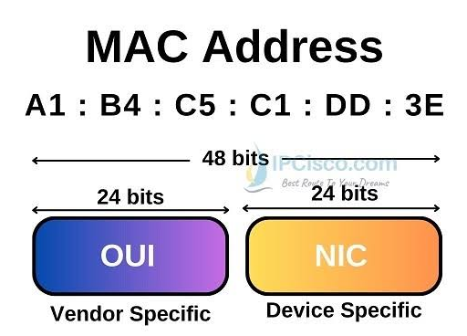
02
ADDRESSING
2. MAC Address
Physical addresses ensure hardware-specific identification on the local network.
2.1. MAC Denifition
2.2. What is the purpose of MAC address?
2.3. MAC Types
2.4. MAC Address Table
10/23

Slide 12
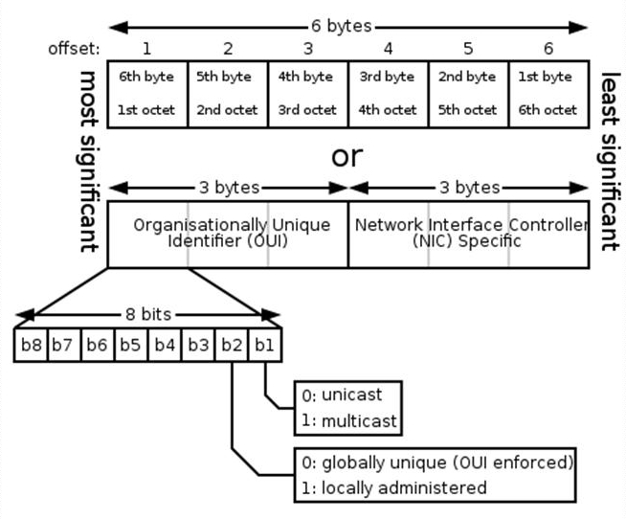
2. MAC Address
2.1 What is MAC address?
A MAC address (Media Access Control address) is a physical or hardware address assigned to each network device.
A MAC address is a 48-bit (6-byte) binary string, written as 12 hex characters in pairs, separated by hyphens, colons, or periods (00:1A:2B:3C:4D:5E).
OUI: Organizationally Unique Identifier; first 24 bits. The vendor ID issued by IEEE.
NIC-Assigned: Vendor-Assigned last 24 bits. Set by the vendor for each physical card; one OUI supports up to 2^24 devices.
11/23

Slide 13
2. MAC Address
2.2 Why is a MAC address needed?
Device identification in a local area network (LAN) : MAC addresses enable network switches to determine exactly which piece of hardware should receive a given data packet, ensuring there is no confusion.
MAC Filtering: A network administrator or a Wi-Fi modem can be configured to allow only those devices with MAC addresses included in a trusted list to connect to the network.
Combined with an IP address to send packets from the source machine to the destination machine:
Layer 2 uses MAC addresses and is responsible for packet delivery from hop to hop.
Layer 3 uses IP addresses and is responsible for packet delivery from end to end.
12/23

Slide 14
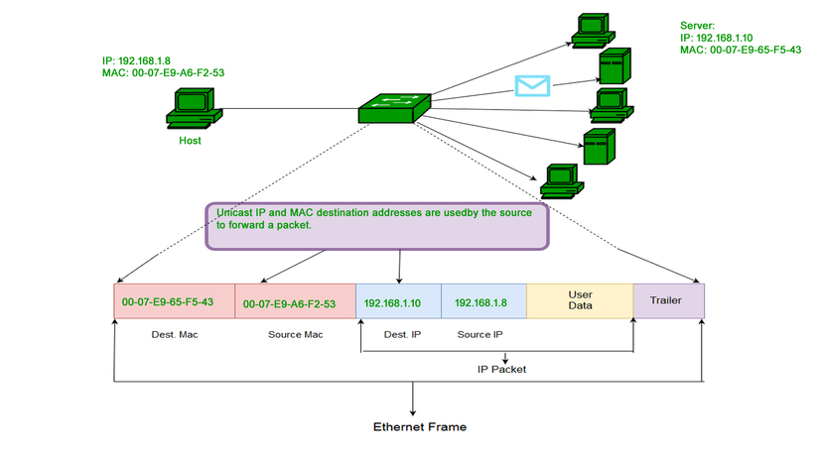
2. MAC Address
2.3 MAC Types
Unicast MAC address
A4:5E:60:11:22:33
13/23

Slide 15
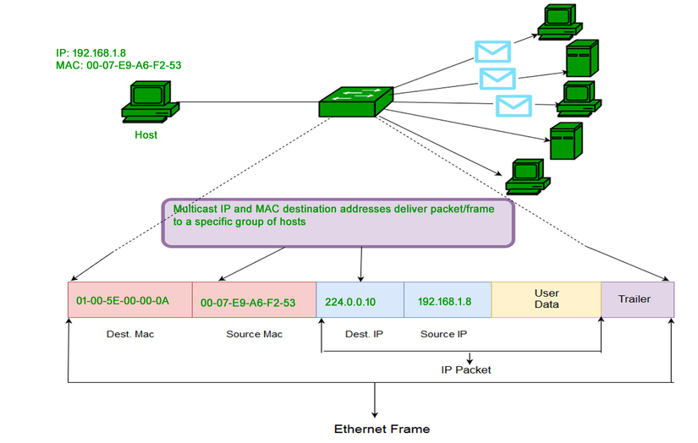
2. MAC Address
2.3 MAC Types
Multicast MAC address
01:00:5E:00:00:0A
14/23

Slide 16
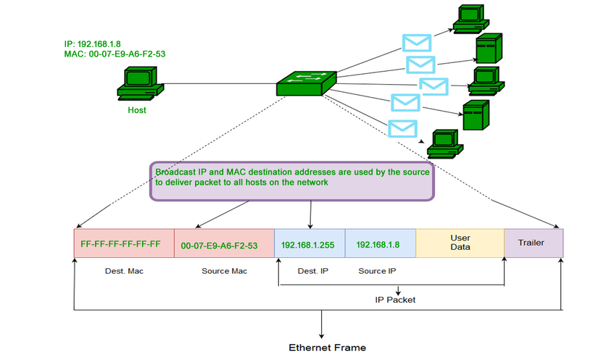
2. MAC Address
2.3 MAC Types
Broadcast MAC address
FF:FF:FF:FF:FF:FF
15/23

Slide 17
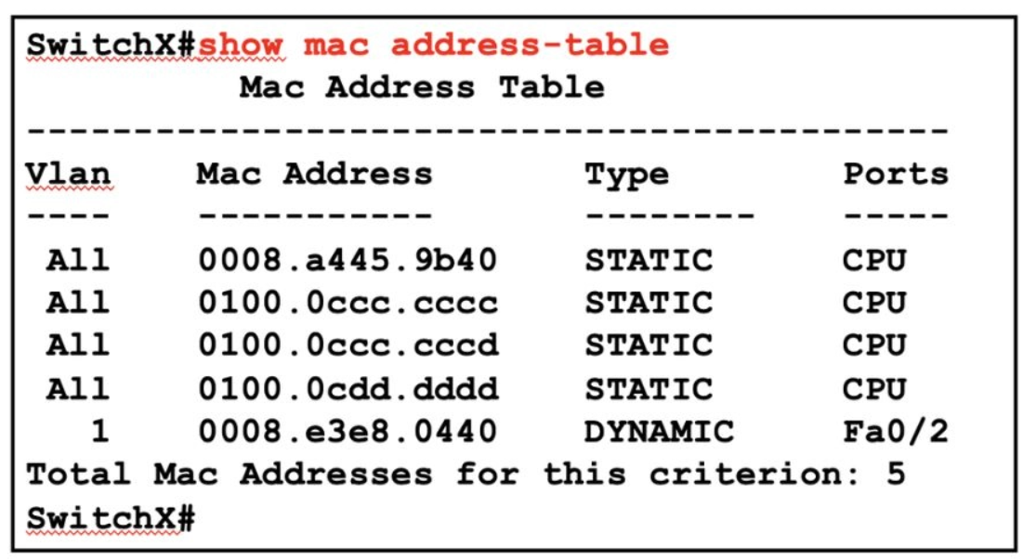
2. MAC Address
2.4 MAC Address Table
The MAC Address Table is a data table stored in the CAM (Content Addressable Memory) of a switch.
The table contains mappings between:
Device MAC address
Corresponding VLAN
Connected port
Entry type (dynamic or static)
16/23

Slide 18
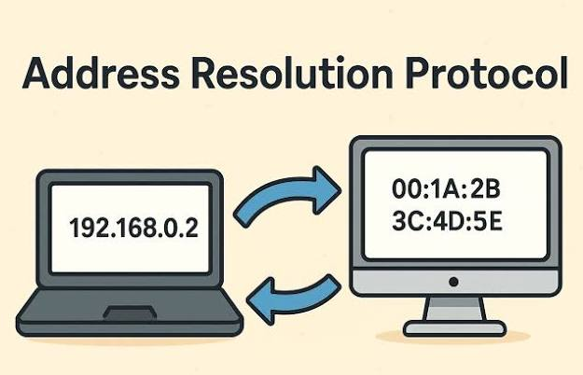
03
PROTOCOLS
3. ARP Protocol
ARP is the translation layer required to bridge IP logical addresses to hardware physical addresses.
3.1 ARP Definition
3.2 ARP Packet Structure
3.3 How ARP works
3.4 ARP Table
17/23

Slide 19
3. ARP Protocol
3.1 ARP Definition
ARP (Address Resolution Protocol) is a network protocol used to map a network address (an IPv4 address) to a physical address (a MAC address) within a local area network (LAN).
The ARP protocol consists of four main types:
Proxy ARP: Designed for devices within a network, it operates within a local scope.
Gratuitous ARP: This type of request helps identify duplicate IP addresses. Gratuitous ARP does not perform a standard IP-to-MAC address resolution request.
Reverse ARP: Used by client systems within a LAN to request an IPv4 address from a router's ARP table.
Inverse ARP: Commonly used in Frame Relay or ATM networks, Inverse ARP is employed to determine the IP address of a node based on its data-link layer address. It obtains the Layer 2 virtual circuit address through Layer 2 signaling.
18/23
Notes:
Hiện tại, giao thức ARP bao gồm bốn loại chính:
Proxy ARP: Được thiết kế cho các thiết bị nội mạng và có phạm vi hoạt động cục bộ. Proxy ARP yêu cầu các thiết bị Proxy trong mạng phải phản hồi cho các yêu cầu ARP không chứa địa chỉ IP nằm trong mạng đó. Nó được sử dụng để xác định vị trí đích cho lưu lượng truy cập và cung cấp địa chỉ MAC của chính nó để sử dụng làm đích.
Gratuitous ARP: Tương tự các quy trình thông thường nhưng thực hiện trên máy chủ, đây là một loại yêu cầu khác của host. Loại yêu cầu này giúp xác định các địa chỉ IP trùng lặp. Gratuitous ARP không gửi yêu cầu dịch hay thực hiện ARP request từ IP sang MAC.
Reverse ARP: Được sử dụng trong hệ thống client trong mạng LAN để yêu cầu địa chỉ IPv4 từ bảng ARP của router. Máy chủ không thể tự nhận diện địa chỉ IP, nhưng có thể sử dụng Reverse ARP để xác định địa chỉ của chính nó. Quản trị viên tạo bảng trong gateway hoặc router để xác định địa chỉ MAC tới IP.
Inverse ARP: Phổ biến trong các rơ-le frame của mạng ATM, Inverse ARP dùng để tìm địa chỉ IP của các node từ địa chỉ lớp liên kết dữ liệu. Nó thu thập địa chỉ mạch ảo ở lớp 2 từ việc signal của Layer 2.

Slide 20
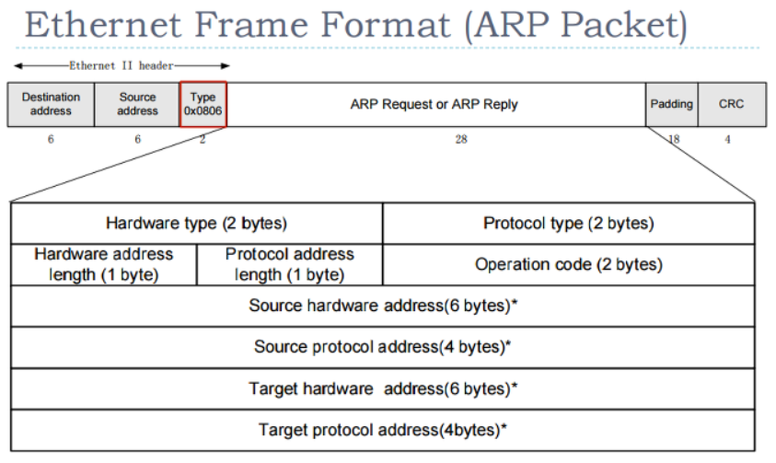
3. ARP Protocol
3.2 ARP Packet Structure
1: Request
2: Reply
19/23

Slide 21
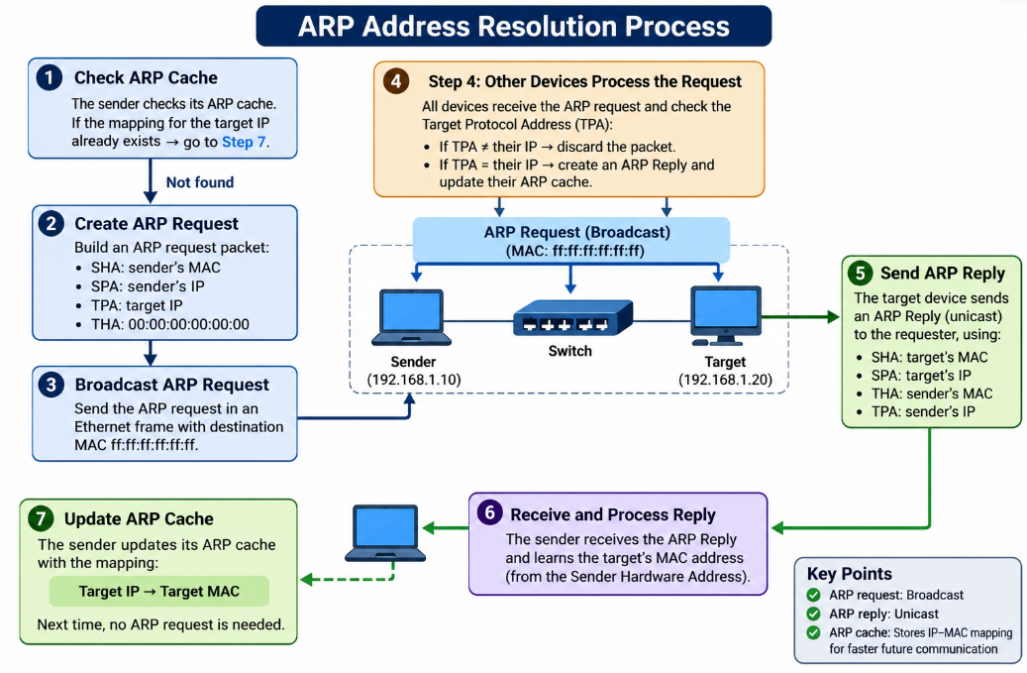
3. ARP Protocol
https://github.com/hocchudong/thuctap012017/blob/master/TamNT/T%C3%ACm%20hi%E1%BB%83u%20giao%20th%E1%BB%A9c%20ARP.md
3.3 How ARP works
20/23

Slide 22
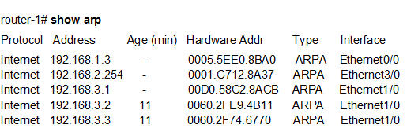
3. ARP Protocol
3.4 ARP Table
The ARP table is a table that stores mappings between IPv4 addresses and MAC addresses for devices with which a computer needs to communicate on a directly connected network.
The ARP table helps to:
Reduce the number of ARP requests.
Decrease network overhead.
Increase data transmission efficiency.
Store information about neighbors that have already been resolved.
21/23

Slide 23
3. ARP Protocol
ARP Table vs Switch MAC Address Table
Feature | MAC Address Table (CAM Table) | ARP Table
OSI Layer | Layer 2 (Data Link Layer) | Layer 3 (Network Layer)
Primary Device | Used mainly by Switches | Used by Routers, PCs, and Servers
Core Mapping | Maps MAC Address to Physical Port | Maps IP Address to MAC Address
Main Purpose | Determines which port to forward a frame to reach the destination device. | Discovers the hardware address (MAC) of a device when only its software address (IP) is known.
22/23

Slide 24
Thank you for listening...
Embedded Trainees

